Slide 1
CHATCONNECT-A REAL TIME CHAT AND COMMUNICATION APP
TEAM MEMBERS:
Gracelin Rubavathy. R [D1CE56E5AE9F14895C9413D574282CEB]
Jasmine Rithika. P [BCA3B0A8D88C397BD304CFE6D1D0F8EA]
Sriharini. A [D36FF5D72DB29FD81CB443C5329137A6]
Menaga. S [CAFD7556E648727B8604886C3DE603C5]
Prisha. S [CCE90DC38569FD891514871ACAD5425E]

Slide 2

Enhancing Real- Time Communication: An In-Depth Overview of Chat Connect

Slide 3




Introduction to Chat Connect
This presentation provides an in-depth overview of Chat Connect, a platform designed to enhance real-time communication. We will explore its features, beneﬁts, and applications in various sectors to understand how it transforms the way we connect and collaborate.

Slide 4
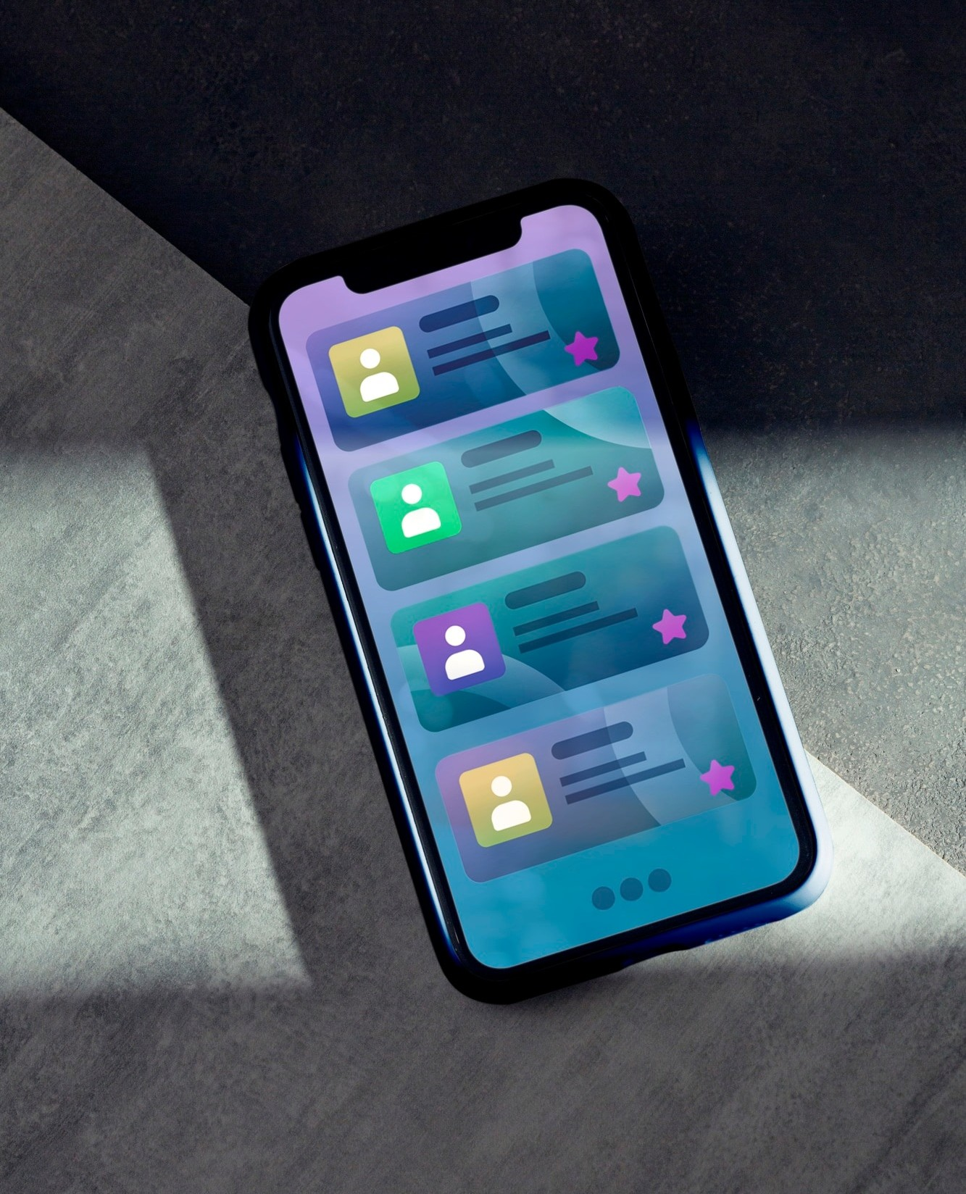


What is Chat Connect?
Chat Connect is a real-time messaging platform that enables users to communicate instantly. It integrates various communication tools to facilitate seamless interactions across different devices and networks, ensuring that users can stay connected at all times.

Slide 5




Key Features
The platform boasts several key features, including group chats, ﬁle sharing, and video calls. These tools are designed to enhance user experience and improve collaboration, making it easier for teams to work together efﬁciently.

Slide 6




User Interface Design
An intuitive and user-friendly interface is crucial for effective communication.
Chat Connect's design focuses on
simplicity and accessibility, allowing users to navigate easily and ﬁnd the tools they need without confusion.

Slide 7



Integration with Other
Tools
Chat Connect can seamlessly integrate with various applications such as calendar tools and project management software. This feature allows users to manage their tasks and schedules without leaving the platform, enhancing productivity.

Slide 8




Security Features
Ensuring user privacy and data security is paramount. Chat Connect employs end-to end encryption and robust security protocols to protect user information and maintain trust in the platform.

Slide 9
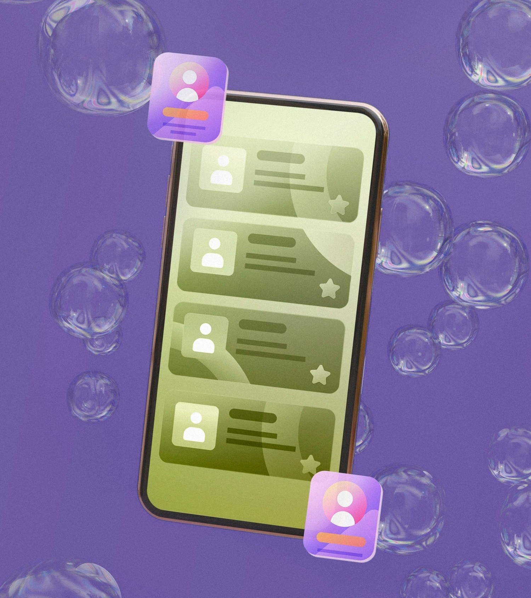


Real-Time Notiﬁcations
To keep users engaged, Chat Connect offers real-time notiﬁcations for messages and updates. This feature ensures that important communications are not missed, enabling timely responses and enhancing overall efﬁciency.

Slide 10



Cross-Platform Compatibility
Chat Connect is designed to work across multiple platforms, including desktop, mobile, and web applications. This ﬂexibility allows users to communicate seamlessly, regardless of
their device or location.

Slide 11

Use Cases in Business
In the business world, Chat Connect enhances team collaboration, improves communication with clients, and streamlines project management. Companies can leverage this platform to create a more connected and efﬁcient work environment.

Slide 12

Educational Applications
Chat Connect can transform educational environments by facilitating communication between students and teachers. Its features support group projects, discussions, and instant feedback, enriching the learning experience.

Slide 13


Customer Support Solutions
For customer support, Chat Connect provides a platform for instant communication with clients.
Businesses can resolve issues quickly, improving customer satisfaction and fostering long-term relationships.

Slide 14



Global Connectivity
Chat Connect breaks down geographical barriers, allowing users from different parts of the world to communicate effortlessly. This global reach enhances collaboration and fosters a diverse environment for ideas and innovation.

Slide 15


Feedback and Improvement
User feedback is essential for the continuous improvement of Chat Connect. Regular updates and enhancements based on user experiences ensure the platform meets evolving communication needs.

Slide 16


Future Developments
Looking ahead, Chat Connect aims to introduce new features such as AI-driven chatbots and advanced analytics tools. These developments will further enhance user experience and streamline communication processes.

Slide 17
Conclusion
In conclusion, Chat Connect is a powerful tool for enhancing real-time communication across various sectors. With its robust features and user-friendly design, it is poised to revolutionize how we connect and collaborate in today's fast- paced world.

Slide 18
Thanks!

